Slide 1
State failures in food policy - food waste in Germany
Prof. Dr. José Martínez
University Göttingen
V MEDITERRANEAN FORUM CEDR
INTERNATIONAL CONGRESS
8th October 2021
Universidad de Valladolid. España
THE CHALLENGE OF THE FIGHT AGAINST FOOD WASTE AND AGRIFOOD CHAIN: costs and results of the new sustainability policies

Slide 2
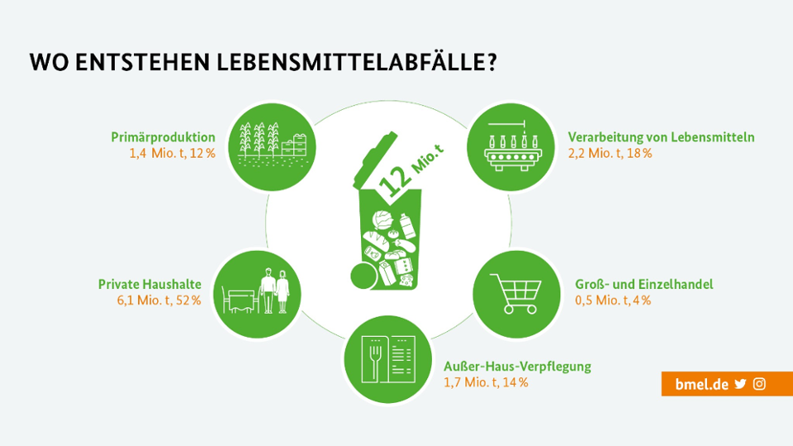
State failures in food policy - food wastage in Germany
12 million tonnes of CO₂ emissions are produced by food waste in Germany every year.
52% of food waste is produced in private households
18 % in food processing
14 % in Gastronomy
Only 4 % in Supermarkets
Dumpster diving is still illegal (theft)

Slide 3
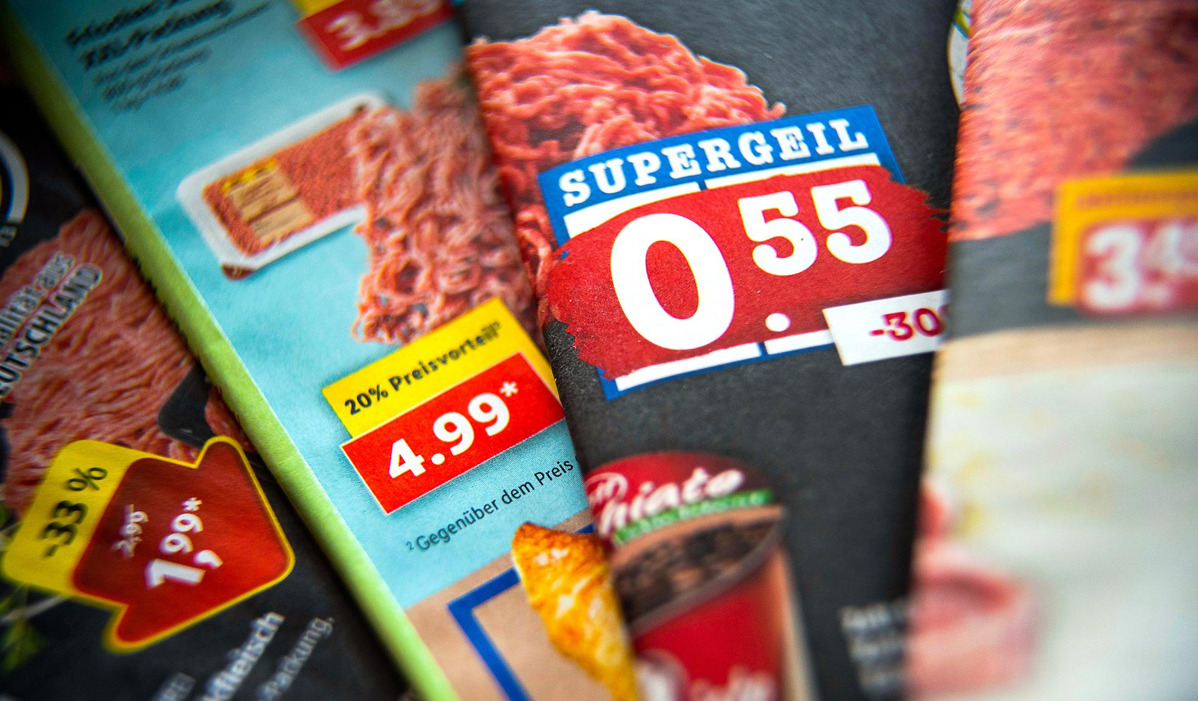
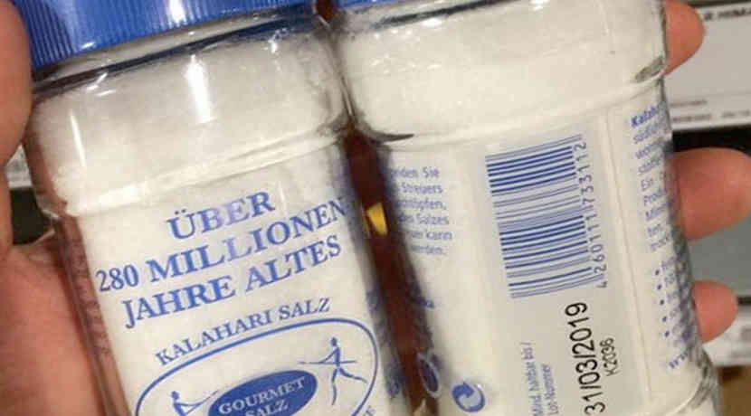
Why is the percentage of private households so high?
The first reason is the low prices for food in Germany.
The second reason is the extensive use of expiriy dates in the food sector.

Slide 4
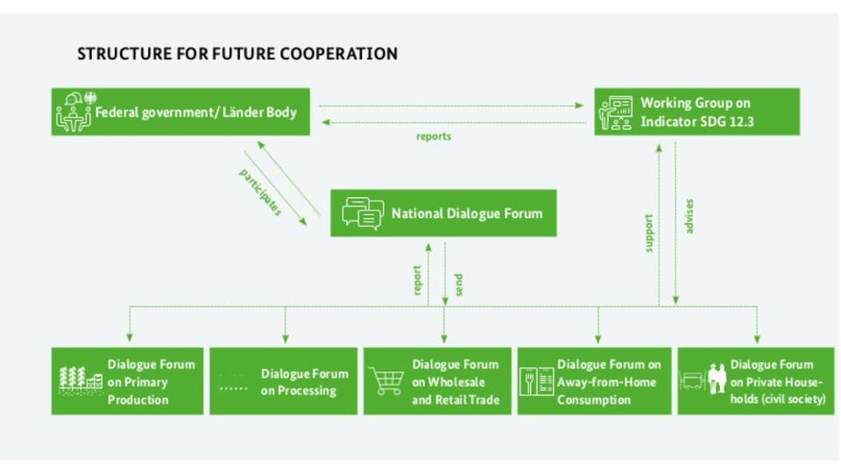
The German way…..
non-binding instruments:
national strategy
voluntary commitments by the industry and the food trade
communication campaigns

Slide 5
communication campaign „Too good for the bin „

Slide 6
How successful are these measures?
reliable data are still lacking for determining food waste quantities
The overall food waste reduction potential in Germany is approx. 11.9 million tonnes
Recent studies (2021) showed no statistically relevant reduction in food waste along the different sectors of the food value chain

Slide 7
Conclusion
The German government does not use all means to reduce food waste.
Two important instruments remain untouched until today for political reasons:
the increase of food prices by raising the tax on food.
the ban on the use of expiry dates for products that cannot expire biologically

Slide 8
BVerfG vom 05.08.2020 (2 BvR 1985/19, 2 BvR 1986/19) - Zur Verfassungsmäßigkeit der Strafbarkeit des sogenannten Containerns als Diebstahl
Leverenz, D.; Schneider, F.; Schmidt, T.; Hafner, G.; Nevárez, Z.; Kranert, M. FoodWaste Generation in Germany in the Scope of European Legal Requirements for Monitoring and Reporting. Sustainability 2021, 13, 6616. https://doi.org/10.3390/su13126616
Müller, Lebensmittelverschwendung als Herausforderung für das europäische Abfallrecht, EurUP 2017, 84-92
Rennicke, Zur strafrechtlichen Behandlung des Containerns de lege lata und de lege ferenda, ZIS 2020, 343-348
Hellermann/Birkholz, Containern - eine sachenrechtliche Herausforderung, Jura 2020, 303-313

